Slide 1
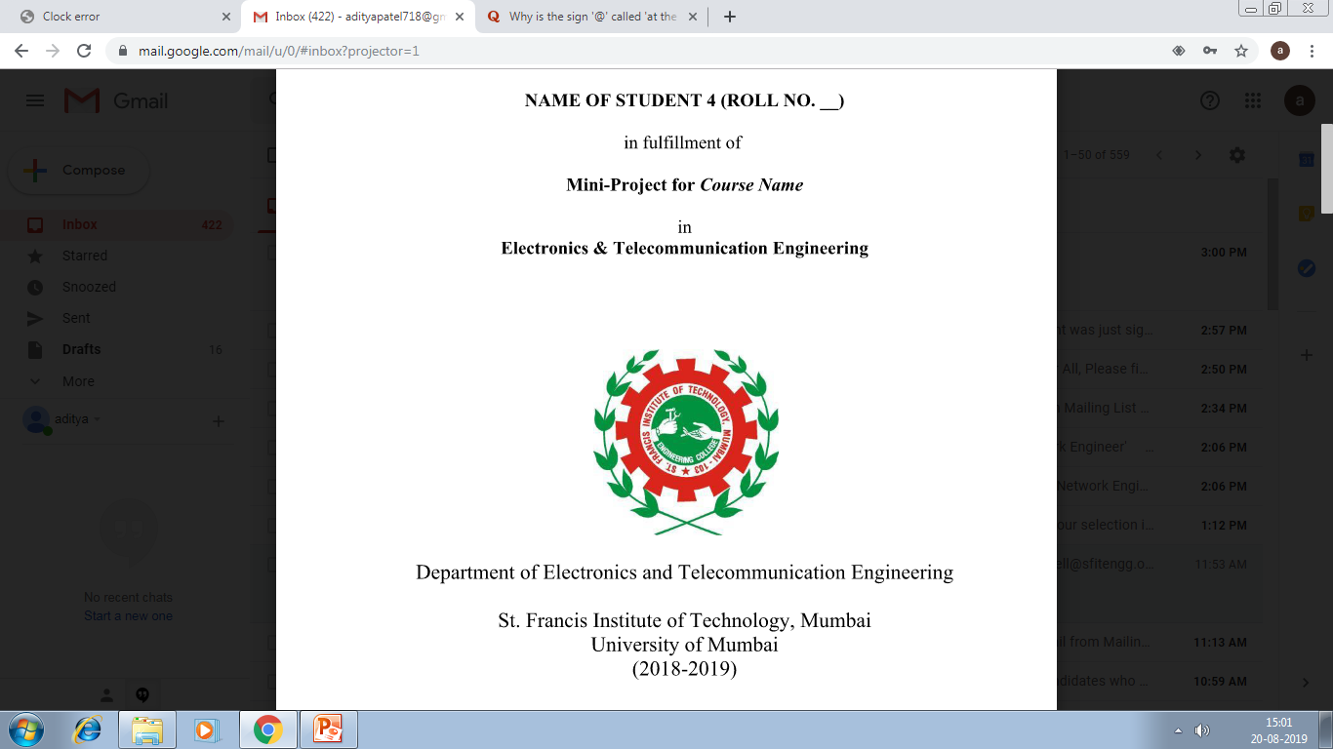
Mini-Project 2B
FPGA Implementation of Linear Image Filtering
Presented by:
Priyank Srivastava (49)
Shreyash Tiwari (55)
Riddhesh Veling (58)
Aditya Vishwakarma (59)

Slide 2
Contents
Introduction
Review of Literature
Research Gaps Identified
Problem Statement
Proposed Solution
System Design
System Requirements
Results
Conclusion
Future Scope
References

Slide 3
Introduction
The Image Enhancement Toolbox is a Verilog-based implementation designed for the Basys3 FPGA.
This project facilitates various image enhancement operations, specifically convolution-based techniques, on a given input image.
The image is sent to the FPGA Block RAM in binary format, where selected image processing operations are performed according to the user's choice.
The processed image is then displayed via a VGA display.
The hardware description language used for this project is Verilog, while Python is employed to convert digital images into binary form. The Vivado software suite was utilized for development.

Slide 4
Review of Literature
IEEE Papers | Description | Results
Implementing Image Processing Algorithms in FPGA Hardware [1] | The paper introduces FPGA-based real-time image processing using windowing operator techniques for filter application. It implements diverse algorithms like median filtering, smoothing, Sobel edge detection. | The experimental results demonstrated the feasibility and effectiveness of FPGA-based hardware design and the paper suggests further research for algorithm enhancement and scalability to larger image sizes.

Slide 5
Review of Literature
IEEE Papers | Description | Results
Image processing on FPGA using Verilog HDL [2] | The tutorial demonstrates Verilog implementation of basic image processing tasks like filtering and edge detection on FPGA. It underscores FPGA's parallel processing prowess, crucial for efficient image processing. | FPGA-based implementations may have limited flexibility compared to software-based approaches, making it harder to iterate and modify algorithms.

Slide 6
Review of Literature
IEEE Papers | Description | Results
High-Level Design for Image Processing on FPGA Using Xilinx AccelDSP [3] | The paper emphasizes FPGA benefits for image processing, including parallel processing and flexibility. It lauds Xilinx AccelDSP for simplifying design through high-level language conversion to RTL HDL. | Choosing Vivado or AccelDSP depends on the specific requirements and complexity of the project. For our project, Vivado would likely be the preferred option.

Slide 7
Research Gaps Identified
The project confirms FPGA's effectiveness in image enhancement but highlights the need for improved algorithms for better performance and efficiency. Further research is also needed to scale the current approach for larger image sizes.
A potential research gap lies in the limited flexibility of FPGA-based implementations compared to software-based approaches, potentially hindering the ease of algorithm iteration and modification.
The determination between Vivado and AccelDSP for FPGA development remains underexplored concerning how specific project requirements and complexities influence the choice.

Slide 8
Problem Statement
There exists a need for flexible and effective system that enables users to make real-time image modifications using user-friendly interface controls.
Develop a resource-efficient architecture capable of executing real-time image enhancement algorithms, such as filtering and color transformation, while optimizing resource utilization and maintaining high throughput.
Implement parallel processing techniques to leverage the inherent parallelism of FPGAs for accelerating image processing tasks.

Slide 9
Proposed Solution
Optimized algorithms and hardware implementations for faster execution of convolution-based techniques.
Developed strategies to efficiently utilize Block RAM resources and maximizing resource utilization.
Implemented parallel processing techniques to leverage FPGA's inherent parallelism for accelerated image processing tasks.
Designed an intuitive interface with user-friendly controls for seamless interaction and ease of use.
Explored hardware-software co-design approaches to maximize performance and resource utilization through synergistic utilization of FPGA hardware and software algorithms.

Slide 10
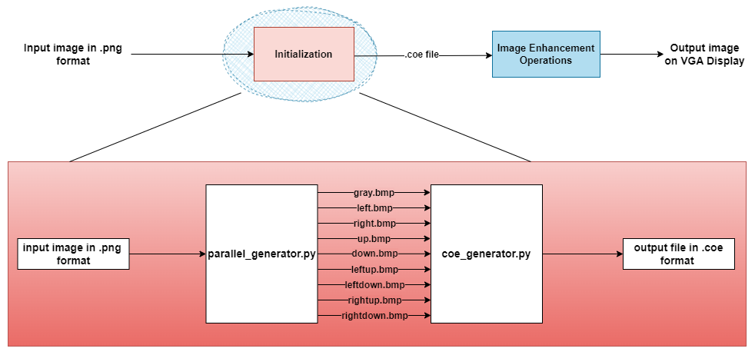
System Design

Slide 11
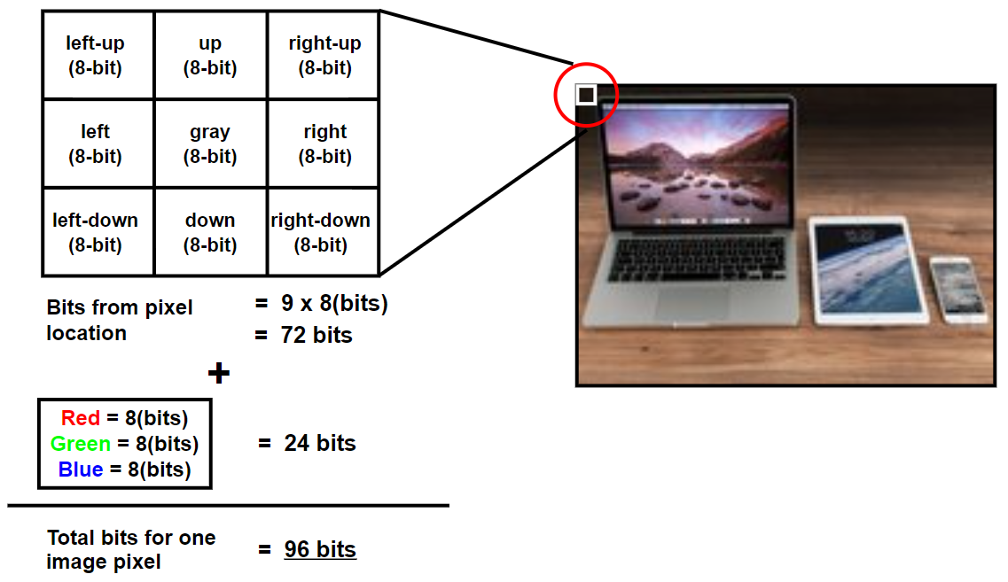
System Design
Example image

Slide 12
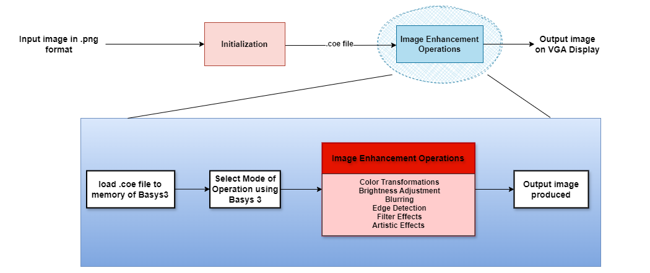
System Design

Slide 13
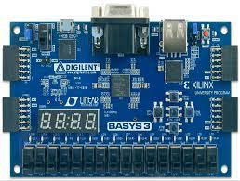
System Requirement
Basys-3 FPGA Development Board:
The Basys 3 is an entry-level FPGA development board designed exclusively for the AMD Vivado Design Suite featuring the AMD Artix 7 FPGA architecture.
4-digit 7-segment display​
5 user pushbuttons​
16 user LEDs​
16 user switches​
USB HID Host for mice, keyboards and memory sticks​
12-bit VGA output
4 Pmod ports: 3 Standard 12-pin Pmod ports, 1 dual purpose XADC signal standard Pmod port

Slide 14
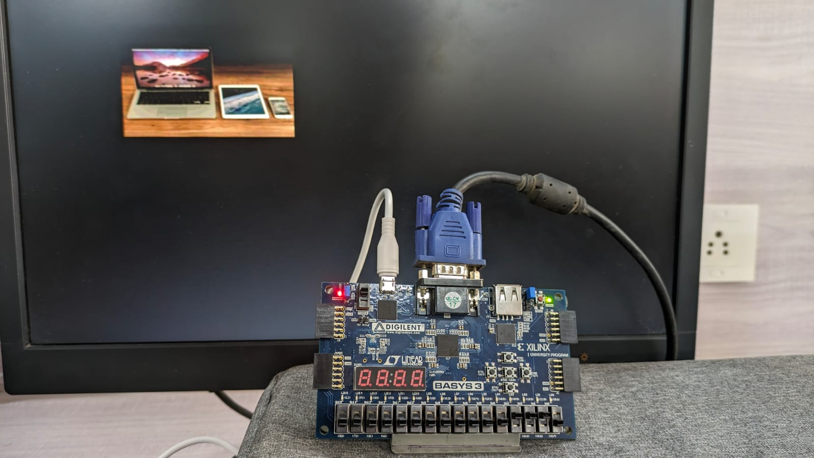
System Requirement
VGA Interface:
A VGA (Video Graphics Array) display is a standard interface used to connect monitors and screens to computers and other devices.
Developed by IBM in 1987.
Transmits analog video signals.
Features a 15-pin connector for video output.
Supports resolutions typically up to 640x480 pixels or higher.
Commonly used for computer monitors, projectors, and TVs.
Provides visual output for gaming, multimedia, and office work.

Slide 15
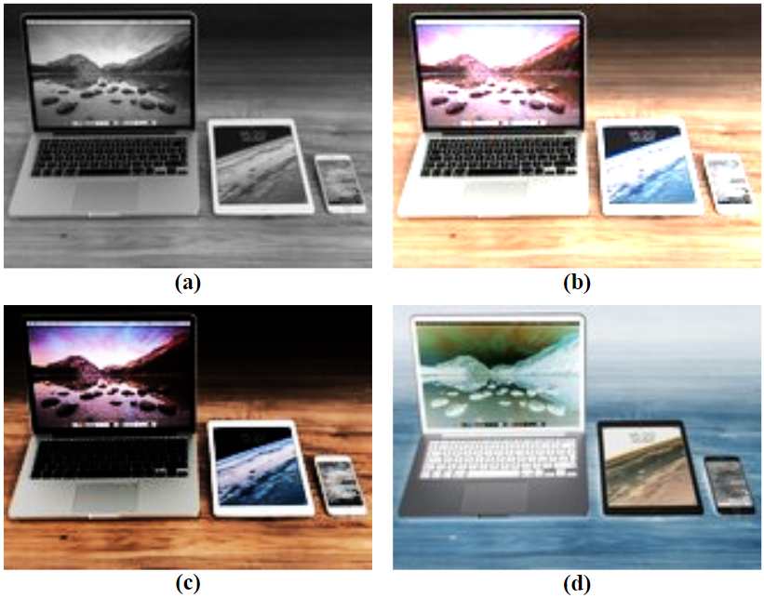
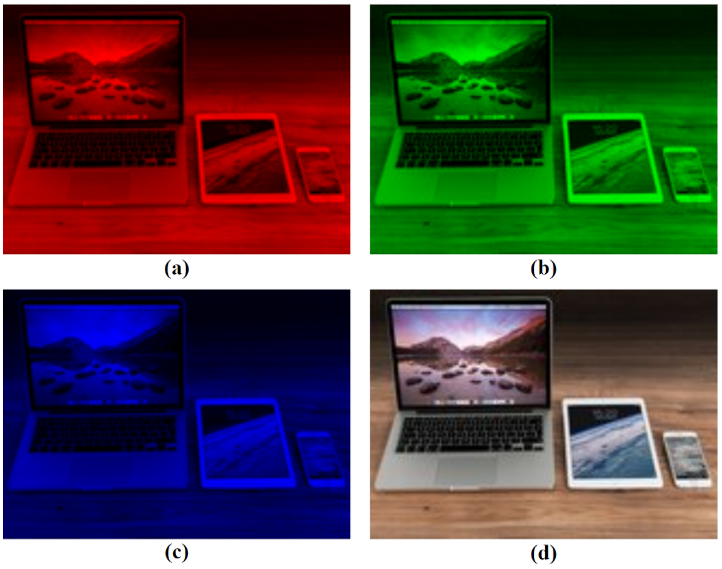
Results
(a) 0000 for RGB to Gray, (b) 0001 for Increase Brightness, (c) 0010 for Decrease Brightness, (d) 0011 for Color Inversion
(a) 0100 for Red Filter, (b) 0101 for Green Filter, (c) 0110 for Blue Filter, (d) 0111 for Original image

Slide 16
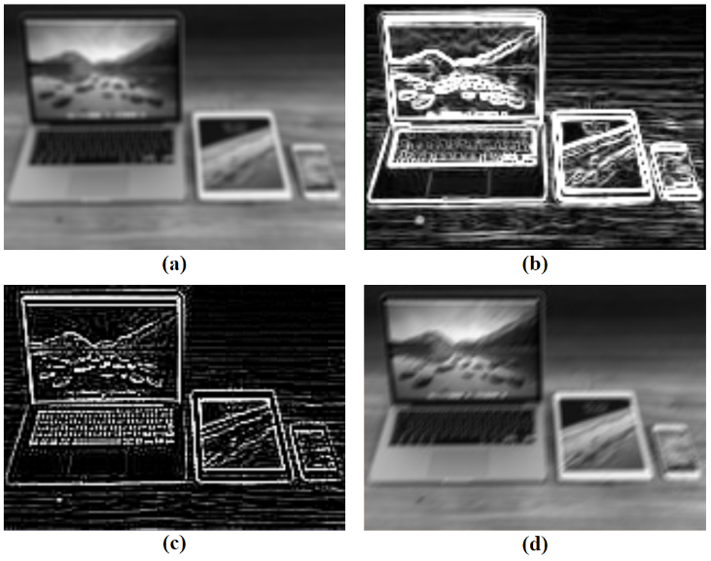
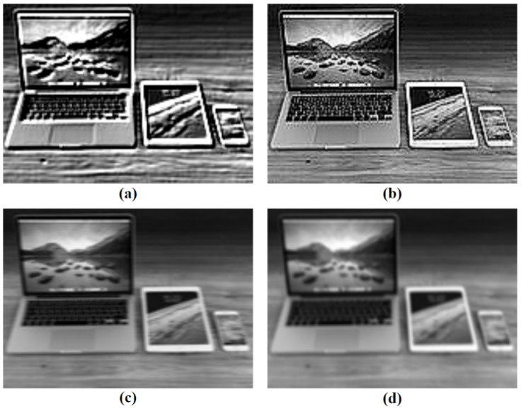
Results
(a) 1000 for Average Blurring, (b) 1001 for Sobel Edge Detection, (c) 1010 for Outline(Laplacian Edge Detection), (d) 1011 for Motion Blurring (xy)
(a) 1100 for Embossing, (b) 1101 for Sharpening, (c) 1110 for Motion Blurring (x), (d) 1111 for Gaussian Blurring

Slide 17
Conclusion
FPGA Implementation: The project aims to enhance images using Verilog on Basys3 FPGA.
Resource Management: Efficiently utilizes Block RAM for image storage and VGA interface for display.
Development Tools: Verilog and Python, supported by Vivado software, facilitate FPGA design.
Functionalities: Enables image transfer between PC and FPGA and displays processed images on a monitor.
Enhancements: Potential for performance improvements through hardware accelerators or co-processors.

Slide 18
Future Scope
Addition of Non-Linear Image Filters such as Median Filter and Canny Edge Detection.
Incorporating adaptive filtering techniques that can automatically adjust filter parameters based on the characteristics of the input image, leading to improved performance across diverse image types and conditions.
Developing power-aware algorithms and hardware architectures to minimize energy consumption while maintaining high-performance levels.

Slide 19
References
[1] M. I. AlAli, K. M. Mhaidat, and I. A. Aljarrah, “Implementing Image Processing Algorithms in FPGA hardware,” 2013 IEEE Jordan Conference on Applied Electrical Engineering and Computing Technologies (AEECT), Dec. 2013. doi:10.1109/aeect.2013.6716446
[2] “Image processing on FPGA using Verilog HDL,” FPGA Projects, Verilog Projects, VHDL Projects - FPGA4student.com, https://www.fpga4student.com/2016/11/image-processing-on-fpga-verilog.html (accessed Feb. 13, 2024).
[3] Y. Said, T. Saidani and M. Atri, "High-level design for image processing on FPGA using Xilinx AccelDSP," 2014 World Congress on Computer Applications and Information Systems (WCCAIS), Hammamet, Tunisia, 2014, pp. 1-5, doi: 10.1109/WCCAIS.2014.6916577.

Slide 20
Thank you

